Slide 1









UNDERSTANDING OUR ECOLOGICAL FOOTPRINT 👣
Funded by the European Union. Views and opinions expressed are however those of the author(s) only and do not necessarily reflect those of the European Union or the European Education and Culture Executive Agency (EACEA). Neither the European Union nor EACEA can be held responsible for them.

Slide 2


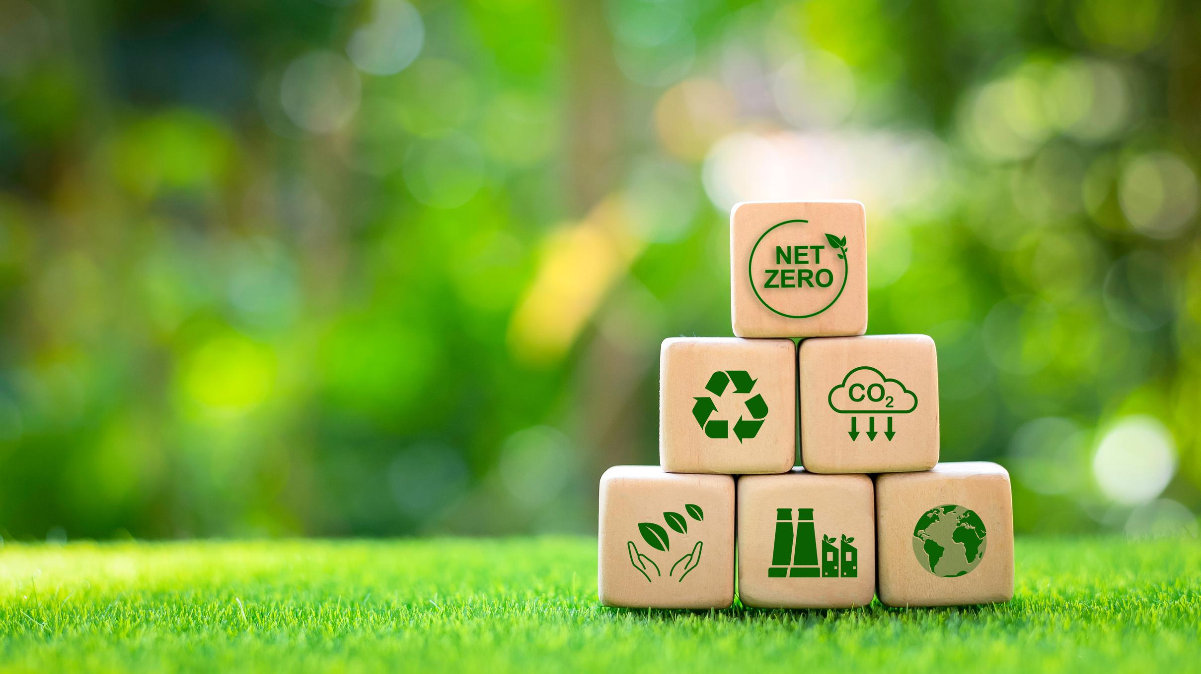
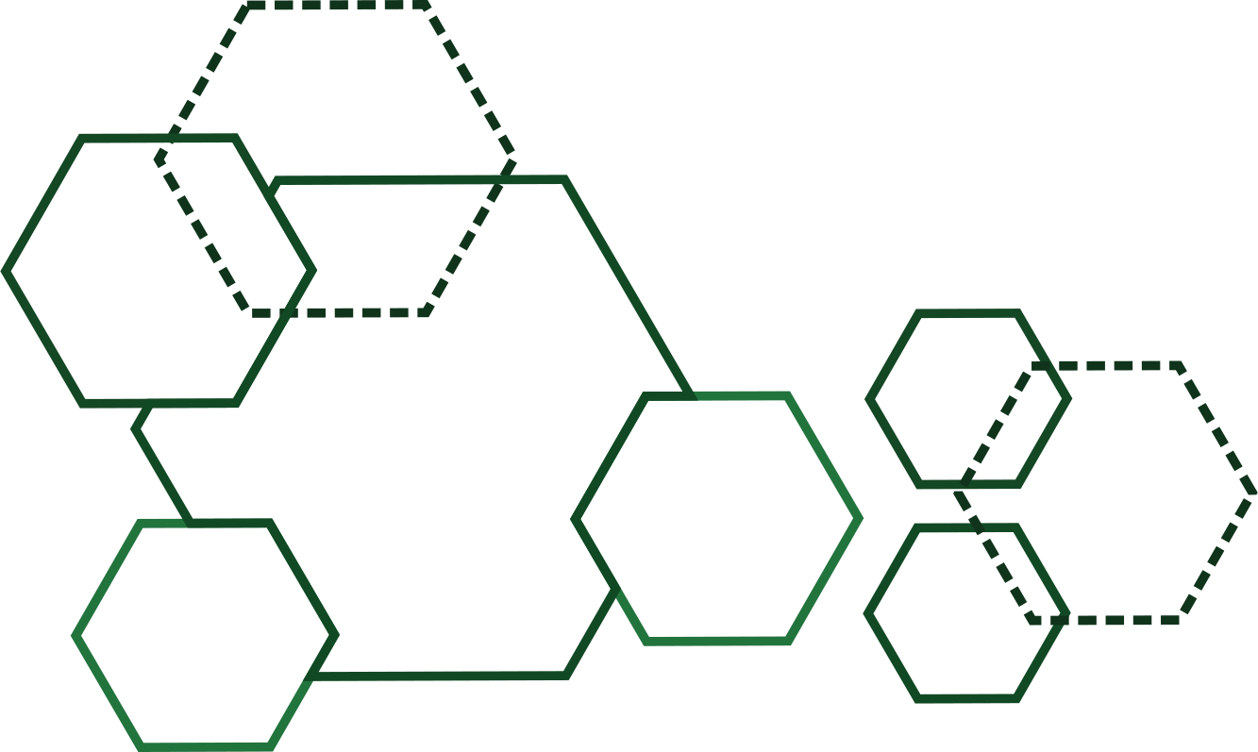
What Does “Ecological Footprint” Mean?
Our ecological footprint is a way to measure how much nature we use to live our lives. It looks at the land, water, and energy that are needed to support our lifestyle. Everything we eat, buy, wear, and use leaves a “mark” on the Earth. That mark is called our footprint.

Slide 3
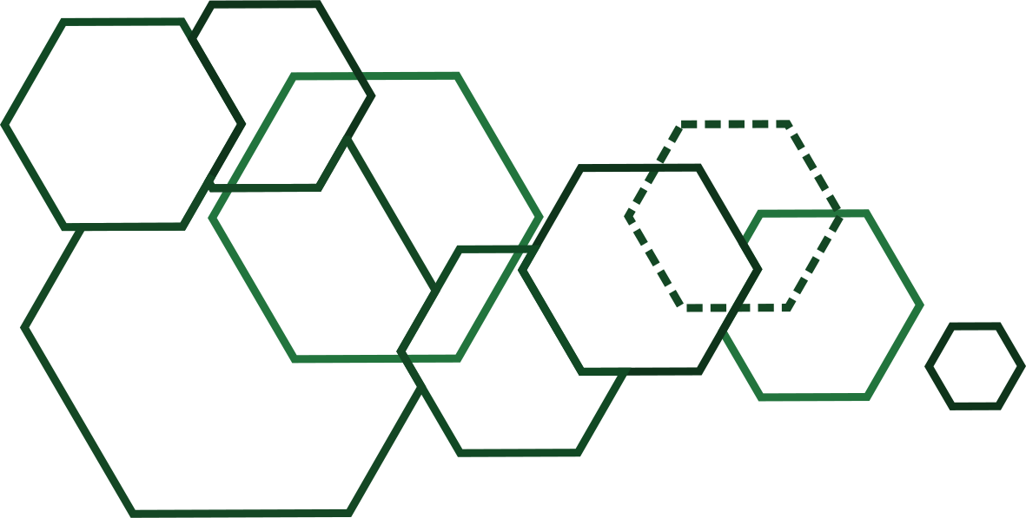

Let’s think about daily life:
When we eat food, farms use land, water, and energy to produce it.
When we buy clothes, factories use materials like cotton or plastic. They also need water and electricity.
When we travel by car or plane, we burn fuel, which produces CO₂.
Even when we charge our phones, we are using electricity that often comes from burning gas or coal.
All of these activities leave a footprint. If everyone takes more than the Earth can give, nature cannot keep up.

Slide 4
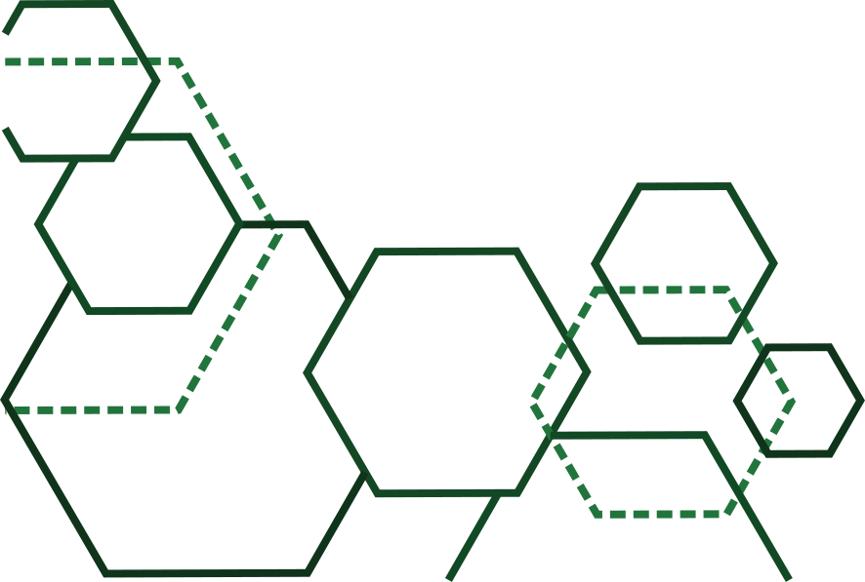
Why Should We Care?
Right now, people on Earth are using more resources than the planet can replace each year. Scientists call this “ecological overshoot.” Imagine you earn 100 euros a week but spend 150. Soon, you will have debt. The same happens with nature. We are “spending” resources from the future.
This creates big problems such as:
Climate change: temperatures are rising, causing extreme weather.
Deforestation: too many trees are cut down for wood, farming, or cities.
Loss of biodiversity: many animals and plants are disappearing.
Pollution: air, soil, and oceans are damaged by waste and chemicals.

Slide 5

Real-Life Examples Students Can Relate To
Food choices:
Producing one hamburger uses about 2,500 liters of water – that is the same as taking 35 showers! Eating more vegetables, beans, or local food makes our footprint smaller.
Fast fashion:
Every year the world throws away about 92 million tons of clothes. Many of them were only worn a few times. Buying fewer clothes of better quality helps the planet.
Transport:
If you cycle or take the bus to school, your footprint is much smaller than if every student comes by car. Planes have one of the largest footprints.
Energy use:
Leaving lights, computers, and phone chargers on when not needed may seem small, but it adds up. Saving electricity reduces our footprint a lot.

Slide 6
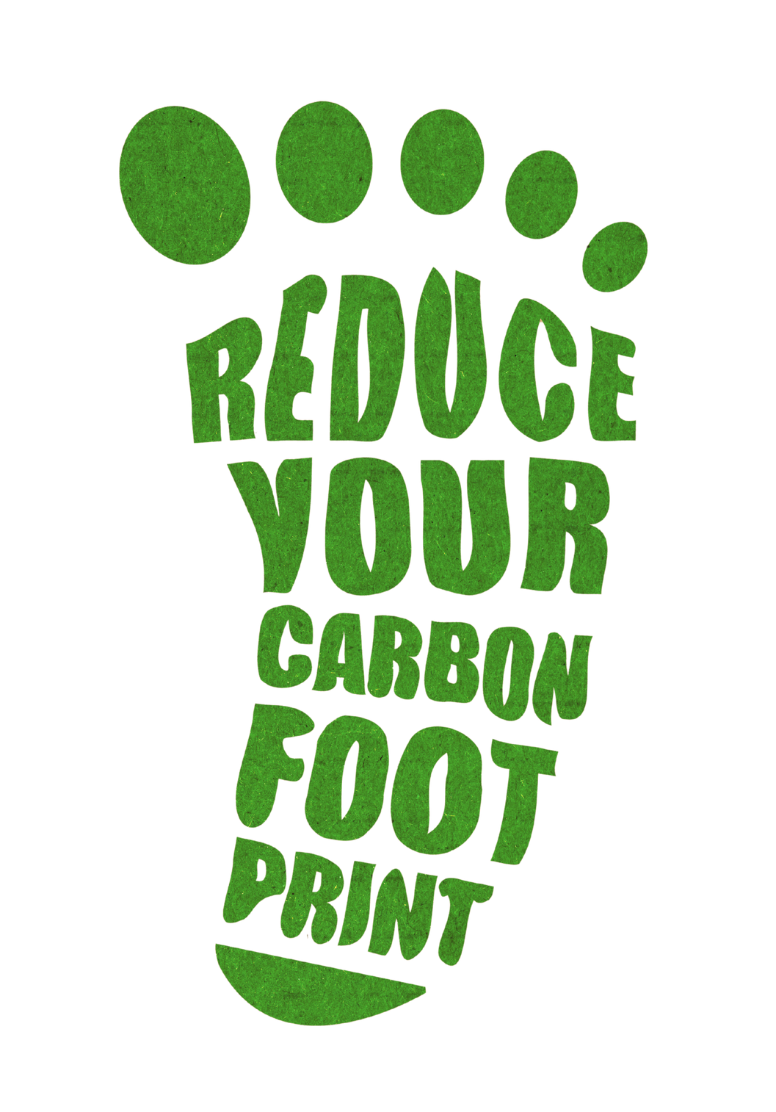
How Can We Reduce Our Footprint?
The good news is that we can all do something. No one can be perfect, but small steps from many people create a big change. Here are some easy ideas:
Eat smart – Try eating less meat and more plant-based food. Choose seasonal fruits and vegetables.
Save energy – Turn off lights, use LED bulbs, and unplug chargers. Don’t waste hot water.
Travel wisely – Walk, bike, or use public transport. Share rides with friends.
Reuse and recycle – Give your old clothes to others, repair your things, recycle paper, glass, and plastic.
Plant trees and protect green spaces – Trees absorb CO₂ and make the air cleaner.

Slide 7


Why Young People Matter?
You may think: “I am only a student, how can I change the world?” But young people are very important. You are creative, energetic, and open to new ideas. You can inspire your families, schools, and communities. If teenagers start caring about their ecological footprint today, the future will be much brighter.
Working together is the key. One person can make a small difference, but when millions of young people take action, the world really changes.

Slide 8

Fun Facts 🌟
If everyone lived like the average person in Europe, we would need almost three planets to support us.
Producing a pair of jeans uses about 7,500 liters of water – the same as 10 years of drinking water for one person.
An average teenager uses around 3,000 plastic bottles before turning 18. Imagine if all of them were reusable!
A single tree can absorb about 22 kilograms of CO₂ each year. Planting one tree is like taking a small car off the road for two weeks.
Around 1.3 billion tons of food is wasted every year worldwide. That is about one-third of all food produced.

Slide 9
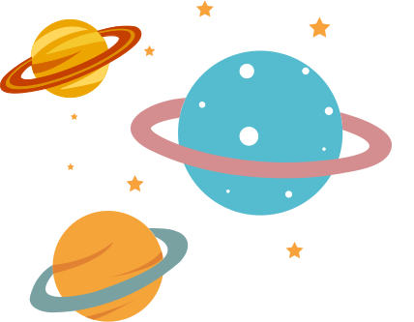
Using a bike instead of a car for just 5 kilometers a day saves about 300 kilograms of CO₂ per year.
If you leave your phone charger plugged in all year, even without a phone, it can waste enough electricity to fully charge a laptop 150 times.
About 90% of plastic ever produced has not been recycled. Much of it ends up in oceans, where it harms animals like turtles and dolphins.

Slide 10

Final Message
Understanding your ecological footprint is not about feeling guilty. It is about learning how to live smarter, in balance with nature. Every time you choose to recycle, save energy, or eat a sustainable meal, you are helping the planet. Each step is like a footprint toward a greener future.
Remember: there is no Planet B. Our Earth is unique, beautiful, and our only home. Let’s take care of it together. 🌍💚

Slide 11

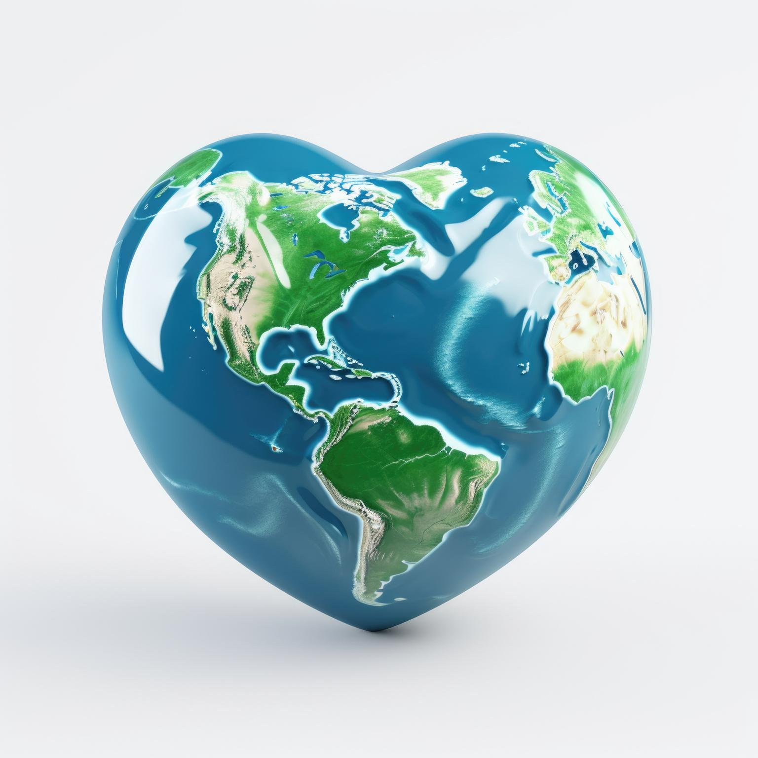
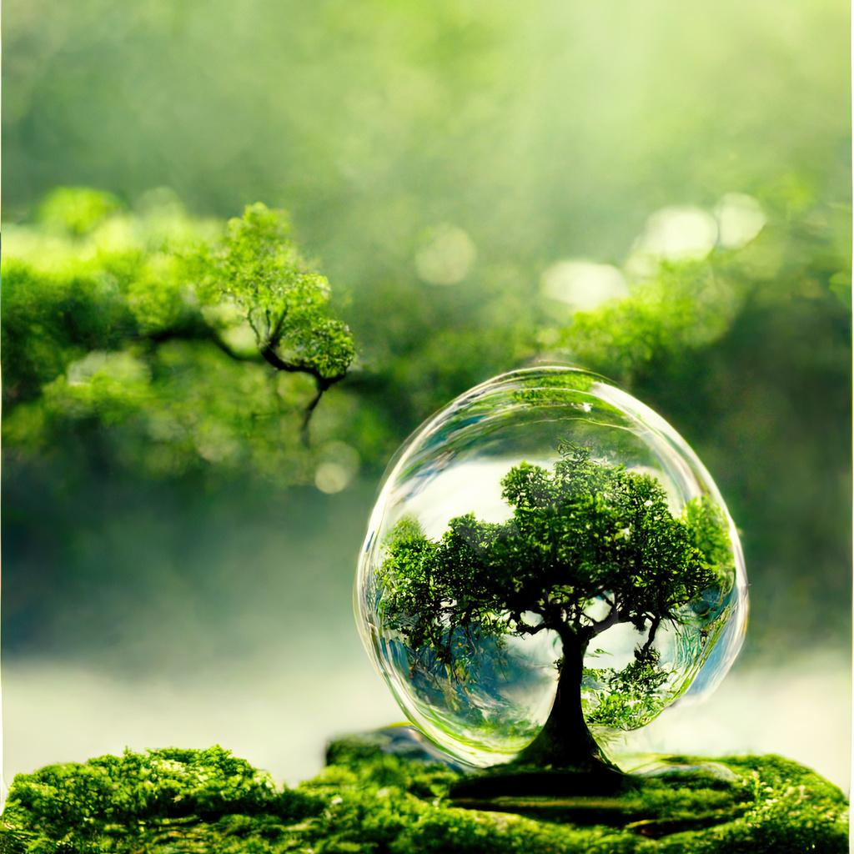

THANK YOU
FOR YOUR ATTENTION

